Slide 1
Yakovleva Viktoriya, A31-2

Slide 2
He's handsome, like fire,
With black stripes
Very menacing fangs
Paws, claws - great!
Scary even for adults it.

Slide 3
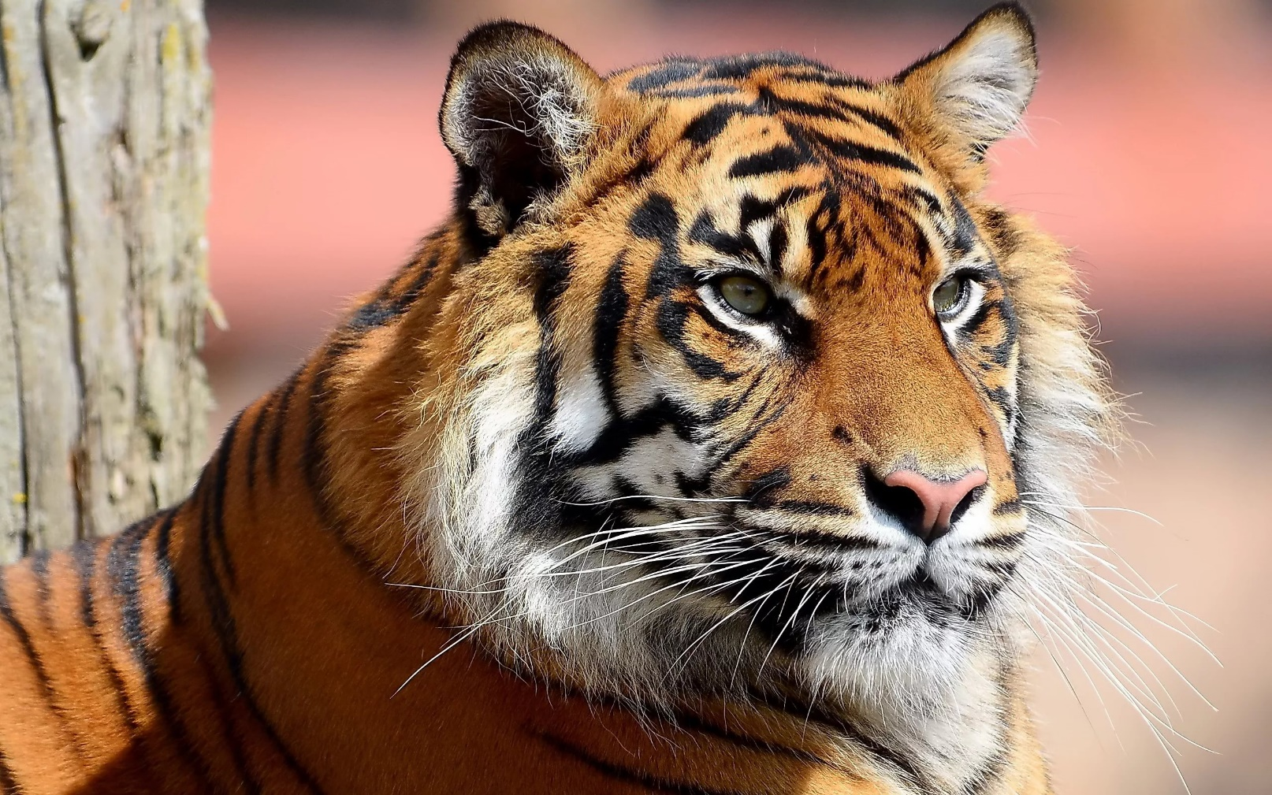
A tiger

Slide 4
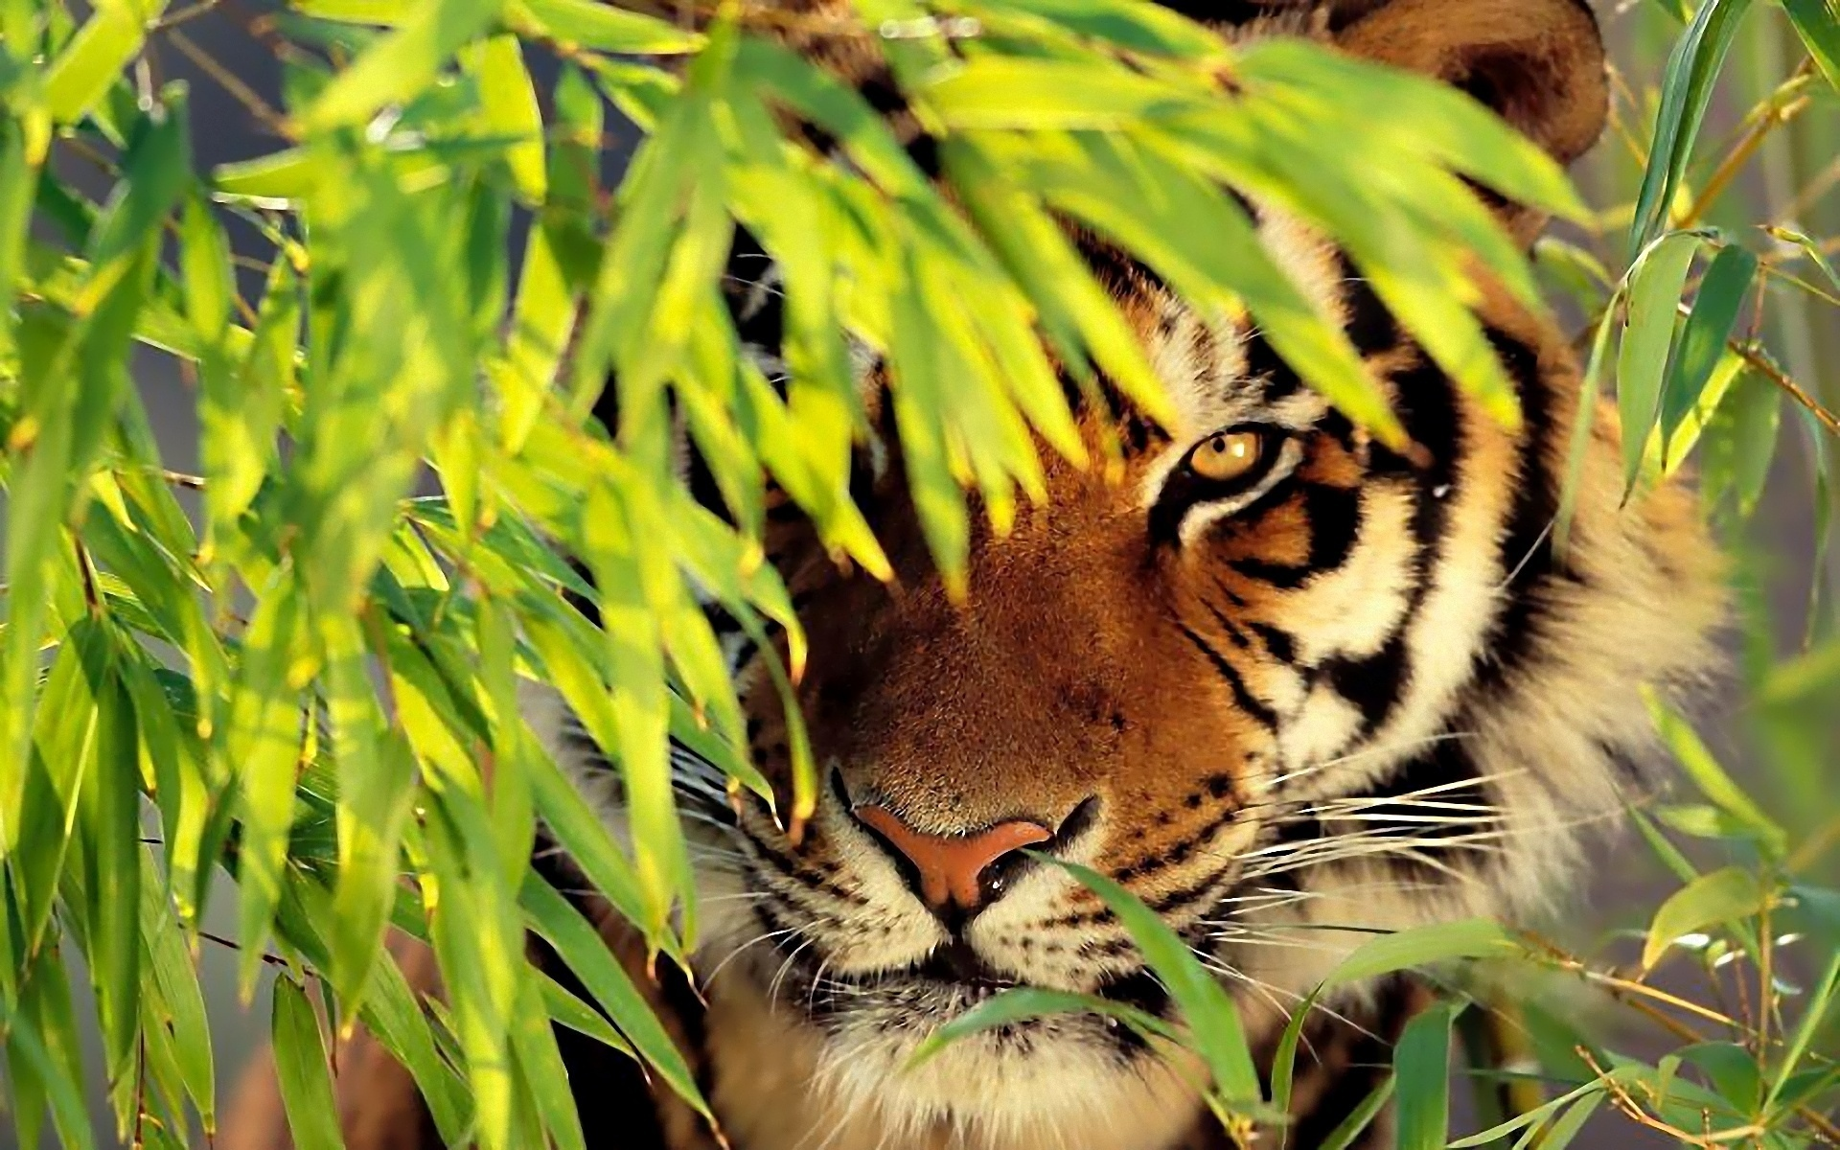
1. It is a wild animal.
2. It is strength.
3. It is one of the largest cats on the Earth.
A tiger can live 15-20 years. A tiger sleeps 12 hours a day. A tiger has 28 teeth. A tiger can eat bears, frogs, fish. Tiger’s wool is 10 cm long. Tiger’s body is 2,2 m long. Tiger’s weight is 165-180 kg.

Slide 5
Hoover is a tiger who was owned by Circo _______, a circus in _______________ Peru where for many years he was ________ to perform in circus acts and live and travel in a tiny, ______ cage.
Tigers are naturally ______________ and love the water.
Trainers drag big cats by _____ chains around their necks and hit them with ____.
Tigers are innately __________ of fire.
More than ______ humans have been injured.
He arrived at __________ frightened, sick and _________.

Slide 6
Do you remember interesting facts about tigers?
How long can these animals live?
How long can this cat sleep?
What does the tiger eat?

Slide 7
Your home task is to write an informative text about some interesting animal and present it to the class. The rest of the students will guess what kind of animal it is

